Slide 1
Endocrine Pancreas
Date: 04-06-2025
Dr. Yerra Vishnu Akhil Raj Kumar
Senior Resident, AIIMS Bibinagar
MBBS- AIIMS Patna
Bio-Design Fellow- IIT Hyderabad
MD Physiology- AIIMS Raipur

Slide 2
Contents
Case Scenario
Basic Functional Anatomy
Secretions and Functions

Slide 3
Case Scenario

Slide 4
A 22-year-old woman with a history of Type 1 Diabetes Mellitus is brought
to the emergency department with complaints of nausea, vomiting, and
abdominal pain for the past 2 days. She also reports polyuria, polydipsia,
and increasing fatigue. She has missed her insulin doses for the past 3 days.
On examination:
BP: 90/60 mmHg
HR: 112 bpm
RR: 28/min with deep, rapid breathing (Kussmaul respiration)
Temperature: 37.5°C
GCS: 15/15
Breath: fruity odor noted

Slide 5
Test | Value | Normal Range
Blood glucose | 460 mg/dL | 70–110 mg/dL
Arterial pH | 7.12 | 7.35–7.45
Serum bicarbonate | 9 mEq/L | 22–28 mEq/L
Serum ketones | Strongly positive | Negative
Serum sodium | 128 mEq/L | 135–145 mEq/L
Serum potassium | 5.6 mEq/L | 3.5–5.0 mEq/L
Urine ketones | Positive | Negative

Slide 6
What is the most important initial step in the management of this
patient?
A. Administer intravenous insulin bolus B. Start sodium bicarbonate infusion C. Begin aggressive intravenous fluid resuscitation D. Administer potassium chloride immediately

Slide 7
Basic Functional Anatomy

Slide 8
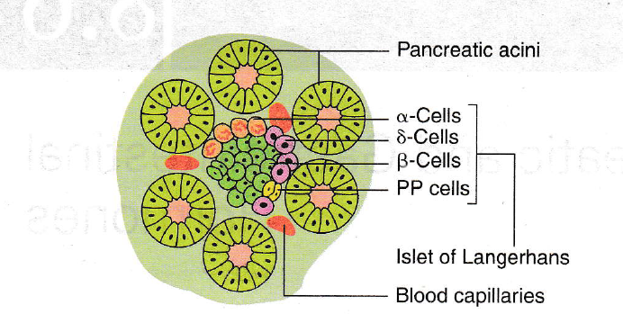

Slide 9
Secretions- Insulin

Slide 10
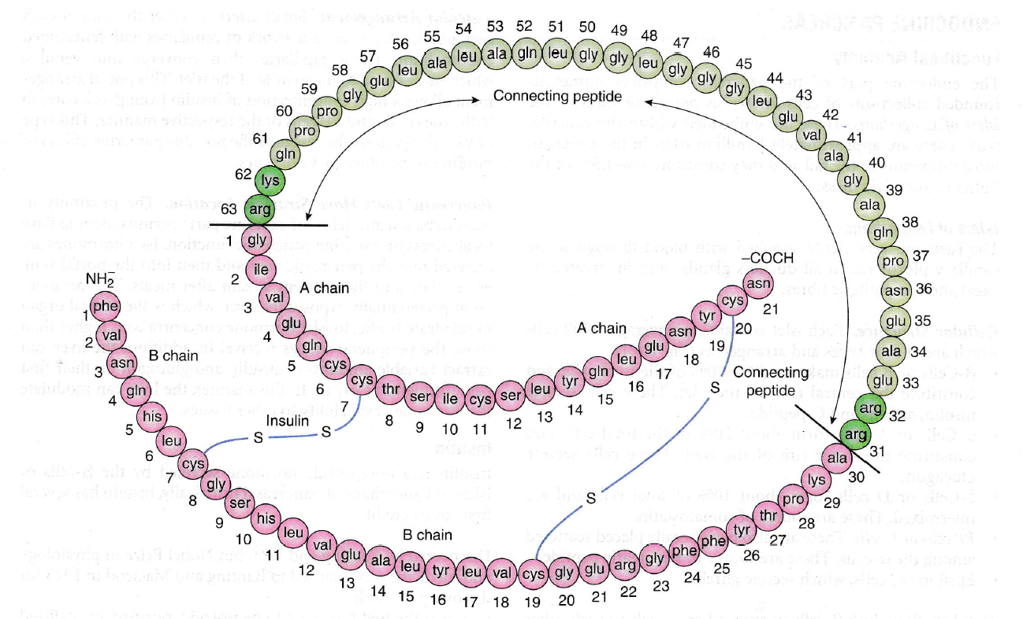

Slide 11
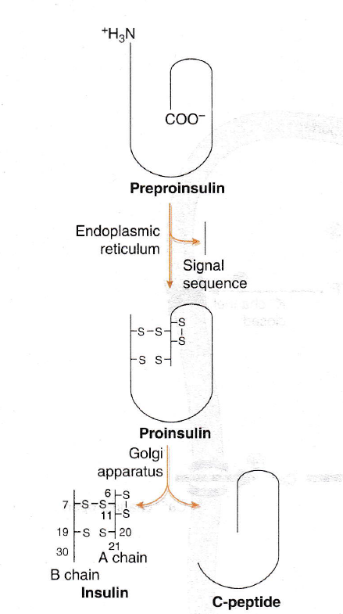

Slide 12
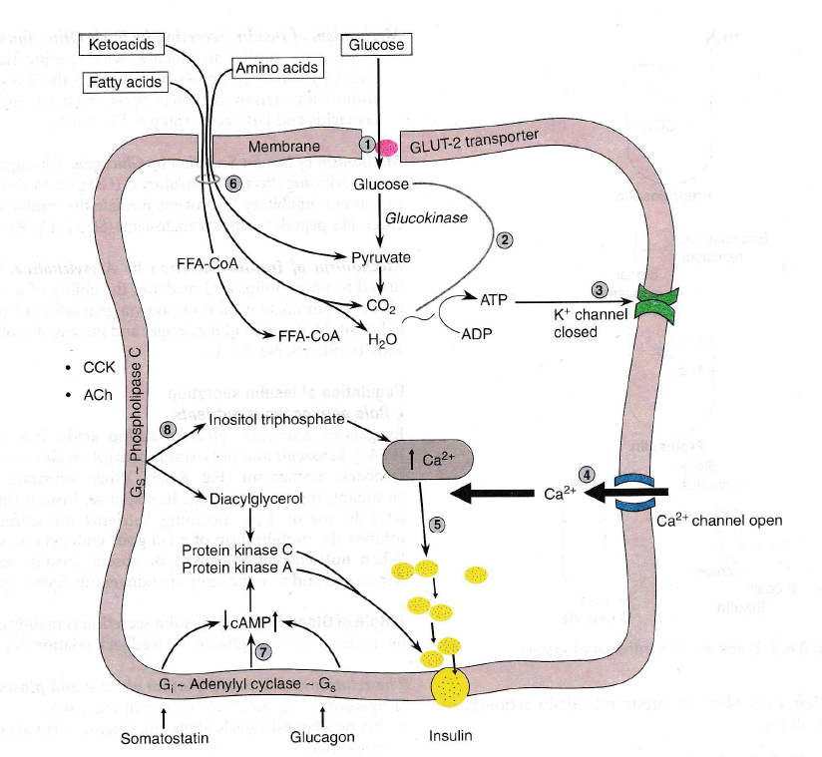

Slide 13
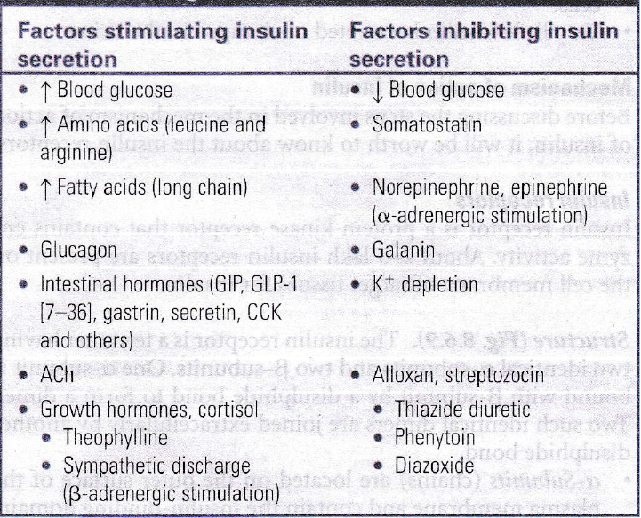

Slide 14
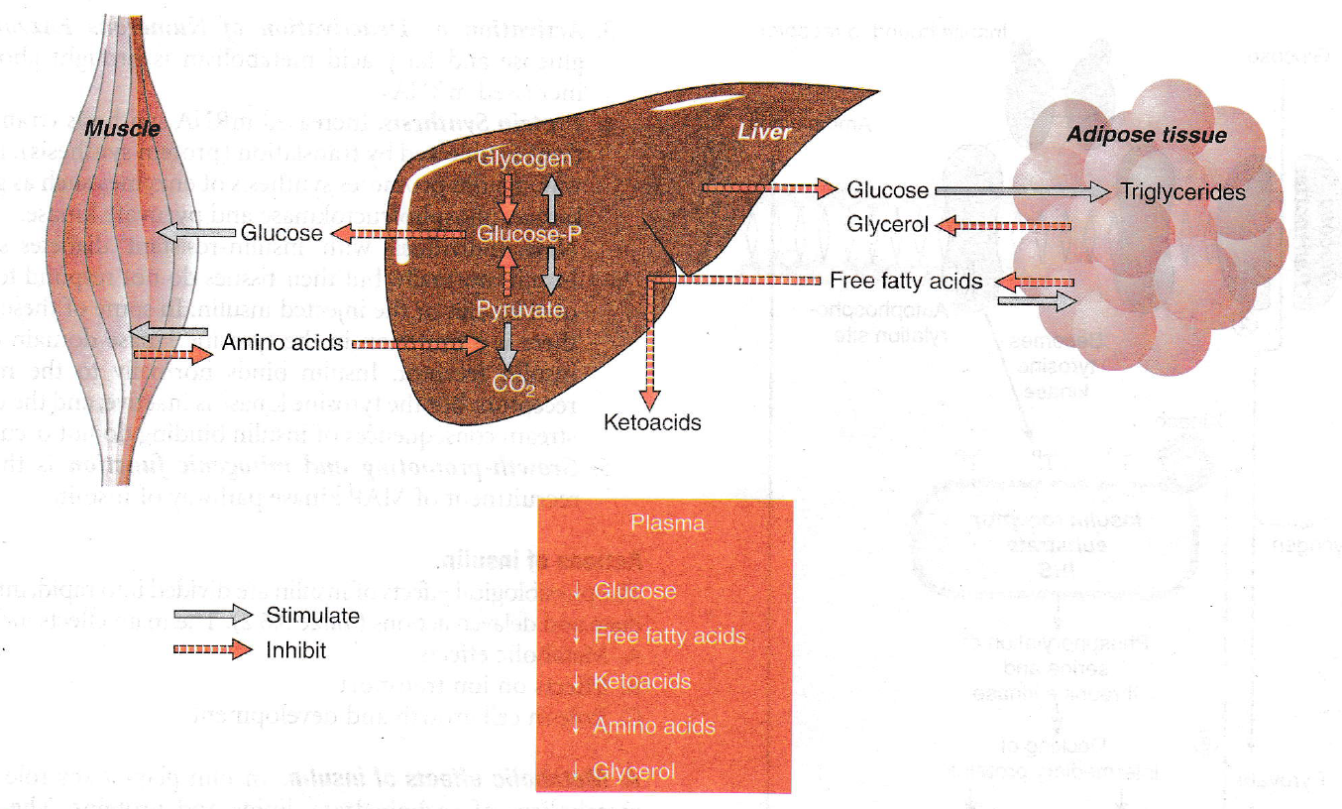

Slide 15
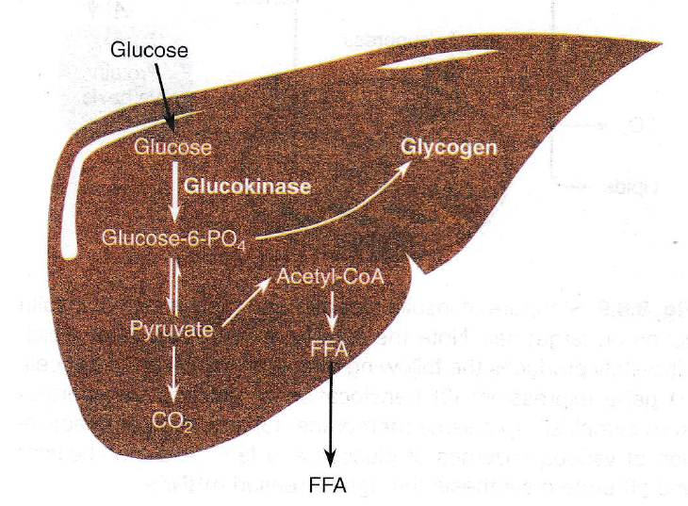

Slide 16
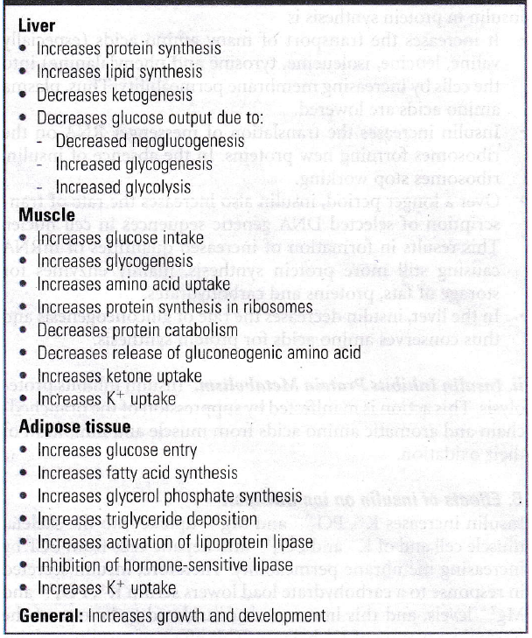

Slide 17
Secretions- Glucagon

Slide 18
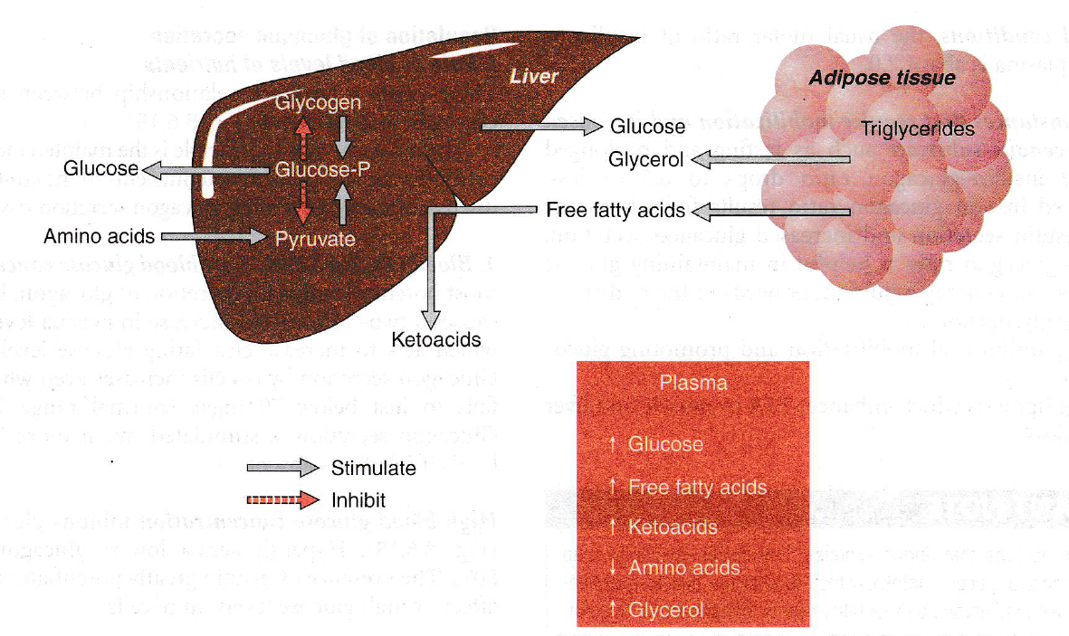

Slide 19
Secretions- Somatostatin and Pancreatic Polypeptide

Slide 20
Somatostatin
Pancreatic polypeptide
Inhibits secretion of both insulin and glucagon.
Increases motility of stomach, duodenum and gall bladder.
Decrease secretion of HCl, Pepsin, Gastrin, Secretin, Intestinal Juice and Pancreatic juice
Inhibits growth hormone secretion
It is secreted response to food ingestion via cholinergic stimulation.
Increased plasma levels of PP serve as markers for the presence of islet cell tumors.

Slide 21
Thank You

